Slide 1


Slide 2
DATA MINING APPROACHES FOR DIAGNOSING CHRONIC KIDNEY CONDITIONS
Batch-11
P.VENNELA (20S41A0590)
MD.NADIR MUJAHID (20S41A0575)
S.DHANA SRI (20S41A05A4)
T.MAHENDAR (20S41A05B3)
Under the guidance of
Mrs.A .KALPANA DEVI
Associate Professor

Slide 3
INDEX
1.INTRODUCTION
2.SYSTEM REQUIREMENTS
3. UML DIAGRAMS
4. IMPLEMENTATION
5. OUTPUT SCREEN
6. CONCLUSION
7. REFERENCES

Slide 4
INTRODUCTION
Data Mining is one of the most encouraging areas of research with the purpose of finding useful information from voluminous data sets. It has been used in many domains like image mining, opinion mining, web mining, text mining, graph mining etc. Its applications include anomaly detection, financial data analysis, medical data analysis, social network analysis, market analysis etc. It has become popular in health organization as there is a requirement of analytical methodology for predicting and finding unknown patterns and information in health data. Data Mining is particularly useful in medical field when no availability of evidence favouring a particular treatment option is found.Data mining comes up with a set of tools and techniques which when applied to this processed data, provides knowledge to healthcare professionals for making appropriate decisions and enhancing the performance of patient management tasks. Patients with similar health issues can be grouped together and effective treatment plans could be suggested based on patient’s history, physical examination, diagnosis and previous treatment patterns. Chronic kidney disease (CKD) has become a global health issue and is an area of concern. It is a condition where kidney s become damaged and cannot filter toxic wastes in the body. Our work predominantly focuses on detecting life threatening diseases like Chronic Kidney Disease (CKD) using Classification algorithms like Naive Bayes and Artificial Neural Network(ANN). :

Slide 5
EXISTING SYSTEM
CKD, in its early stages, has no symptoms; testing may be the only way to find out if the patient has kidney disease. Early detection of CKD in its initial stages can help the patient get effective treatment and then prohibit the progression to ESRD. It is argued that every year, a person that has one of the CKD risk factors, such as a family history of kidney failure, hypertension, or diabetes, gets checked. The sooner they know about having this disease, the sooner they can get treatment. To raise awareness and to encourage those who are most susceptible to the disease to perform the tests periodically, we hope that the disease can be detected with the least possible tests and at low cost. So, the objective of this research is to provide an effective model to predict the CKD by least number of predictors.

Slide 6
DISADVANTAGES
Heterogeneous medical complex physician’s interpretation with poor mathematical classification.
Ethical, legal and social issues.
Privacy and security related to human data administration.

Slide 7
PROPOSED SYSYEM
The main objective is to predict chronic kidney disease (CKD) using classification techniques like Naive Bayes and Artificial Neutral Network(ANN).In proposed system, the experimental results implemented in RapidMiner tool show that Naive Bayes produce more accurate results than Artificial Neural network.

Slide 8
ADVANTAGES
Data mining in healthcare detects fraud and abuse.
Help physicians to identify effective treatments and best practices.
Patients exploit better and greater affordable healthcare services.
Data mining can extract predictive knowledge from large databases.

Slide 9
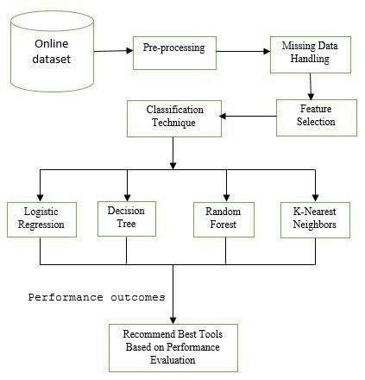
SYSTEM ARCHITECTURE

Slide 10
SYSTEM REQUIREMENTS HARDWARE REQUIREMENTS: System : Pentium IV 2.4 GHz Hard Disk : 40 GB Floppy Drive : 1.44 Mb Monitor : 14’ Colour Monitor. Mouse : Optical Mouse. Ram : 512 Mb. SOFTWARE REQUIREMENTS: Operating system : Windows 7 Ultimate. Coding Language : Python.

Slide 11
MODULES 1. Data collection and Preprocessing Module 2. CNN Model Training Module. 3. Steganography Detection Module. 4. User interface Module. 5. Integration and Deployment Module.

Slide 12
MODULE DISCRIPTION
1.Data Collection and Preprocessing Module: This module is responsible for collecting and preprocessing the text data that will be used for training and testing the CNN model. The module may include sub-modules for data cleaning, feature extraction, and data transformation.
2.CNN Model Training Module: This module is responsible for training the CNN model using the preprocessed text data. The module may include sub-modules for hyperparameter tuning, model selection, and model evaluation.
3.Steganography Detection Module: This module is responsible for detecting the presence of hidden messages in the input text using the trained CNN model. The module may include sub-modules for feature extraction, prediction, and result interpretation.
4.User Interface Module: This module is responsible for providing a user-friendly interface for users to interact with the system. The module may include sub-modules for input/output handling, error handling, and system feedback.
5.Integration and Deployment Module: This module is responsible for integrating all the modules and deploying the system on a target platform. The module may include sub-modules for system testing, version control, and system maintenance

Slide 13
UML DIAGRAMS
UML stands for Unified Modeling Language. UML is a standardized general-purpose modeling language in the field of object-oriented software engineering. The standard is managed, and was created by, the Object Management Group.
The goal is for UML to become a common language for creating models of object-oriented computer software. In its current form UML is comprised of two major components: a Meta-model and a notation. In the future, some form of method or process may also be added to; or associated with, UML.
The Unified Modeling Language is a standard language for specifying, Visualization, Constructing and documenting the artifacts of software system, as well as for business modeling and other non-software systems.
.

Slide 14
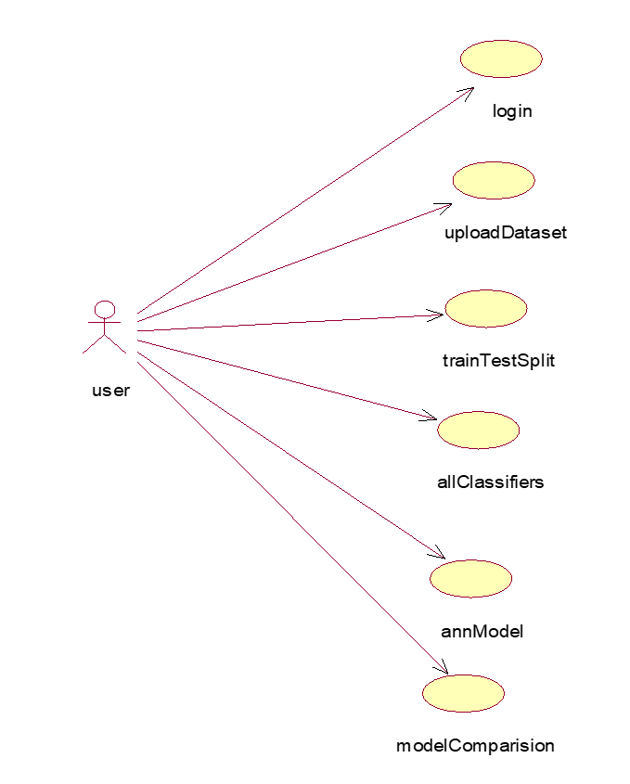
USE CASE DIAGRAM:
A use case diagram in the Unified Modeling Language (UML) is a type of behavioral diagram defined by and created from a Use-case analysis. Its purpose is to present a graphical overview of the functionality provided by a system in terms of actors, their goals (represented as use cases), and any dependencies between those use cases. The main purpose of a use case diagram is to show what system functions are performed for which actor. Roles of the actors in the system can be depicted.

Slide 15
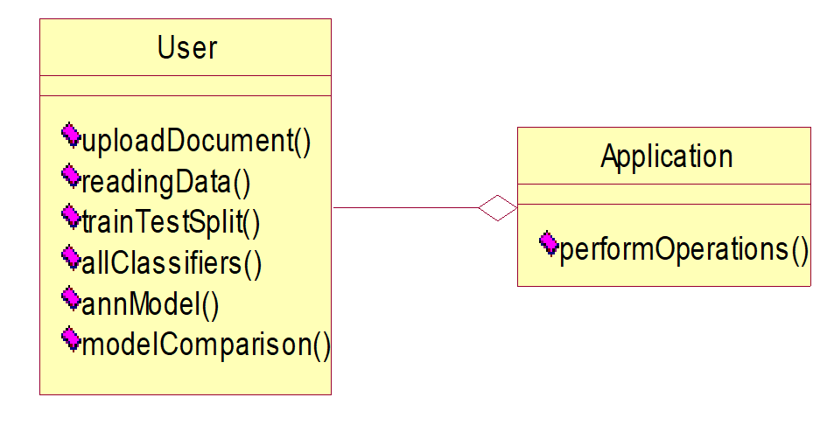
CLASS DIAGRAM :
In software engineering, a class diagram in the Unified Modeling Language (UML) is a type of static structure diagram that describes the structure of a system by showing the system's classes, their attributes, operations (or methods), and the relationships among the classes. It explains which class contains information.

Slide 16
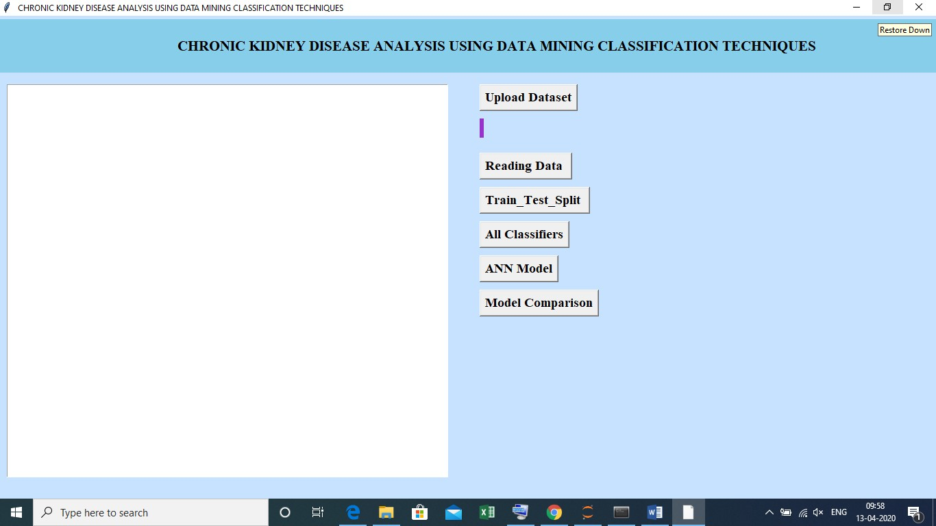
SCREEN SHOTS

Slide 17
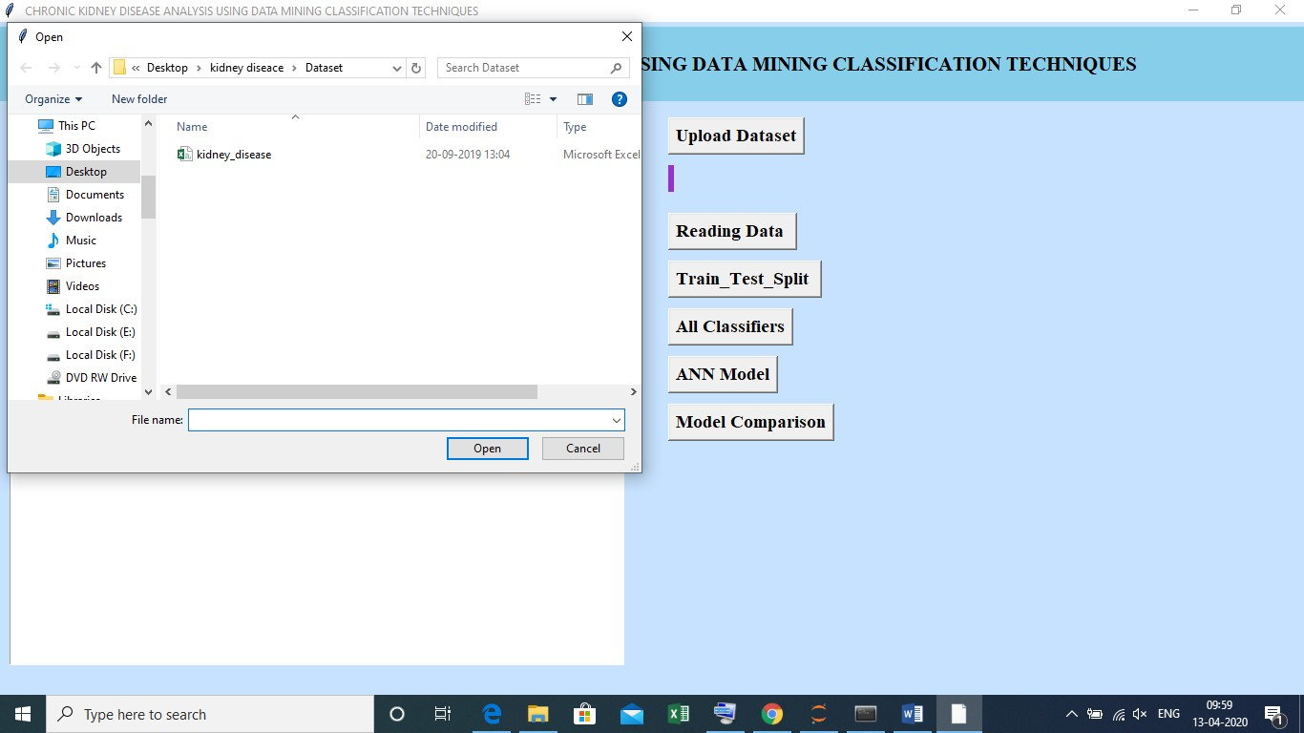
Enter the input

Slide 18
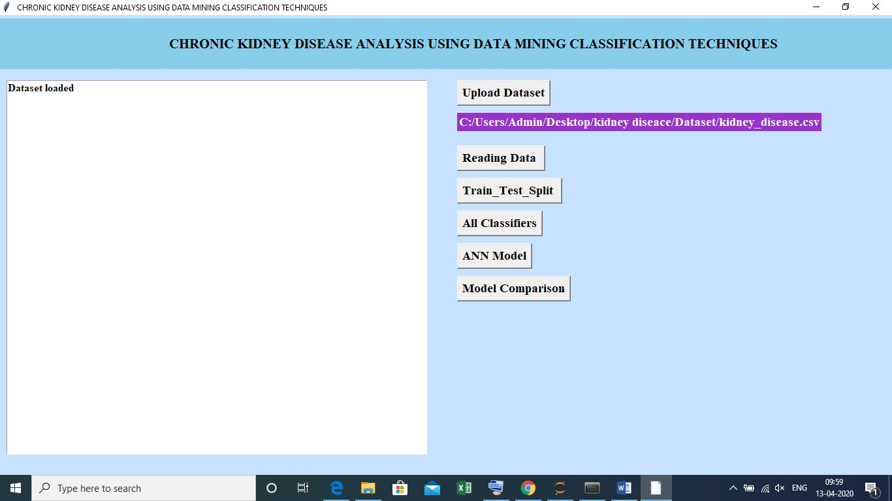

Slide 19
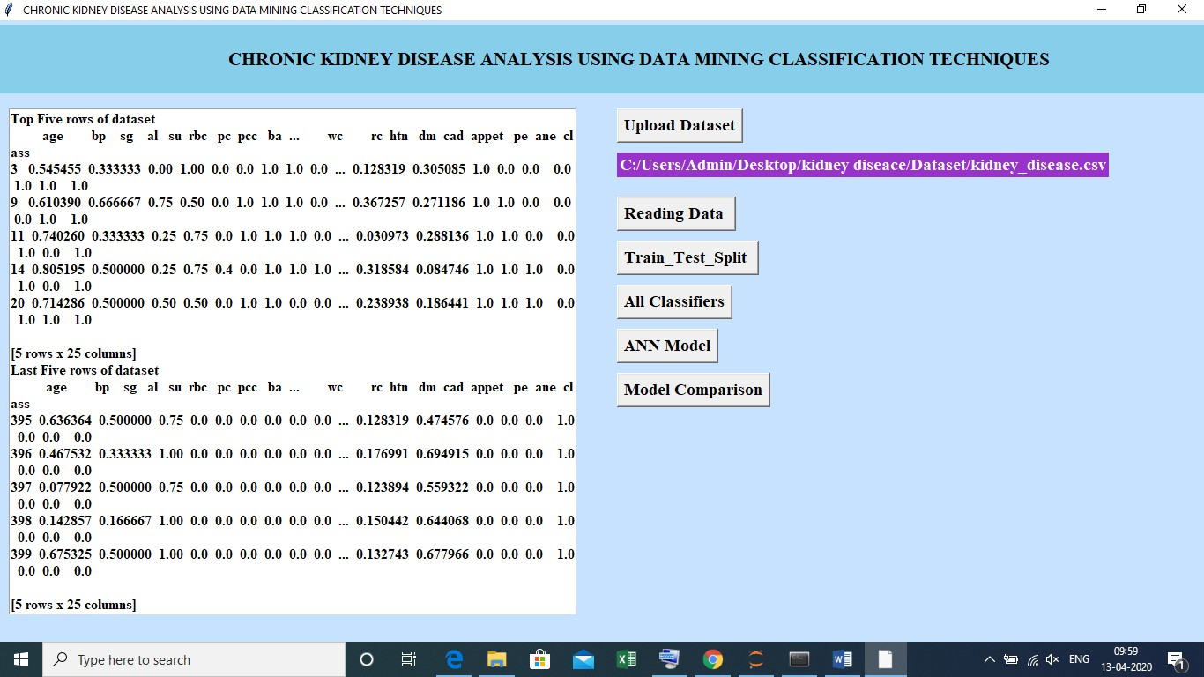
Now click on ‘read data’ it reads the data

Slide 20
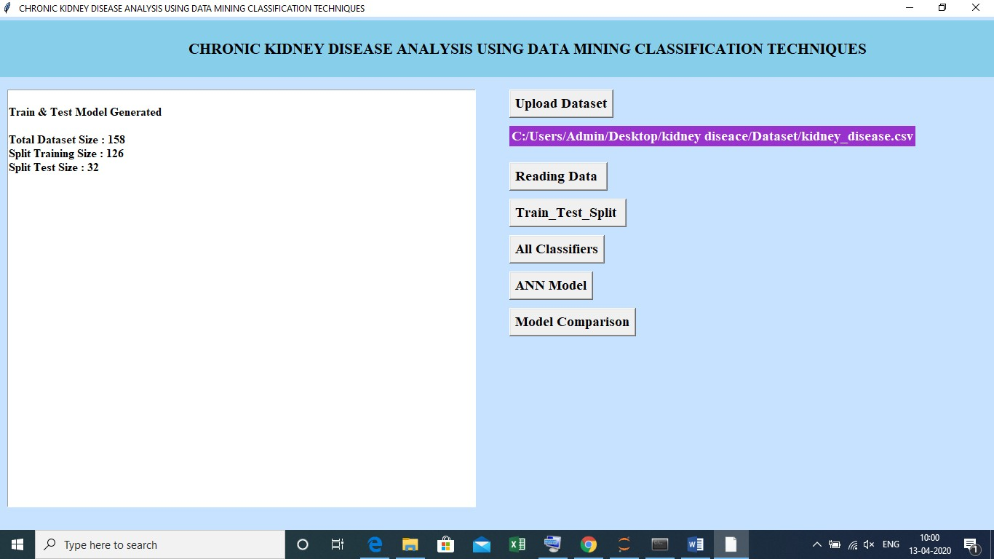
Now click on ‘Train_Test_split’ to split the data into training and testing

Slide 21
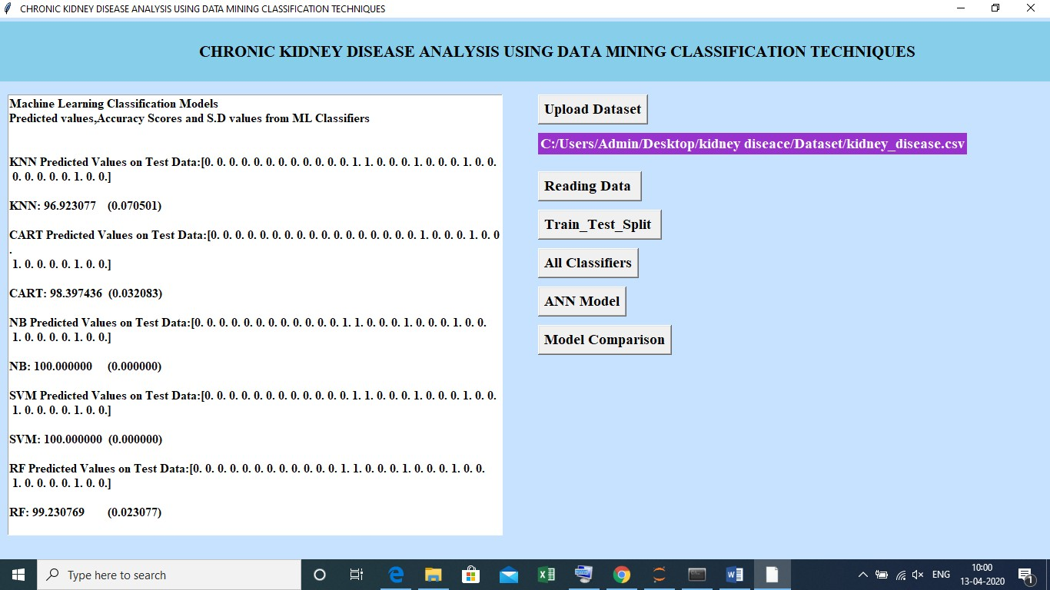
Now click on ‘All classifiers’ to classify the models

Slide 22
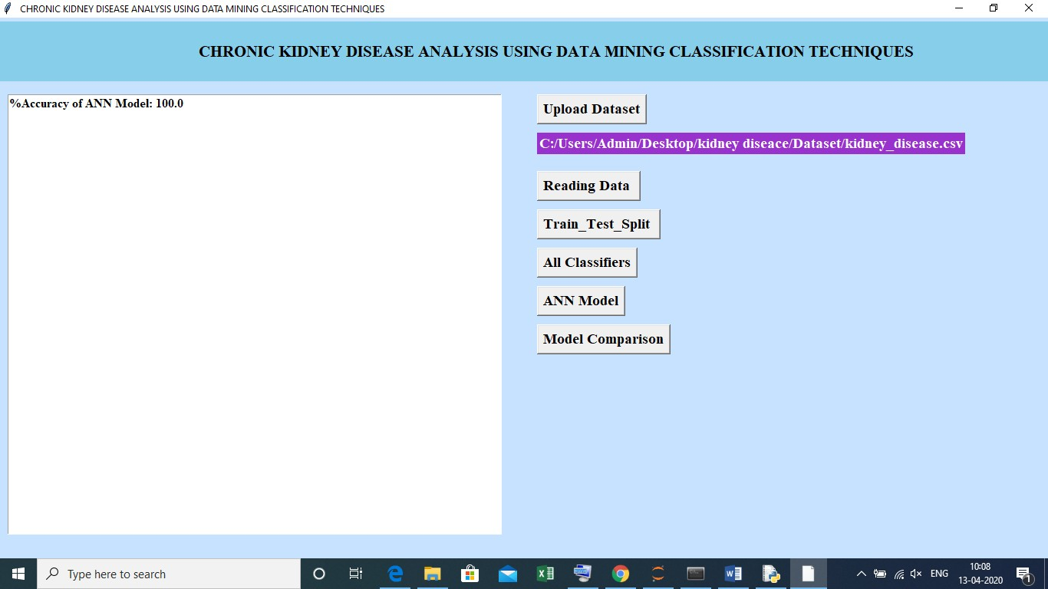
Now click on ‘ANN Model’

Slide 23
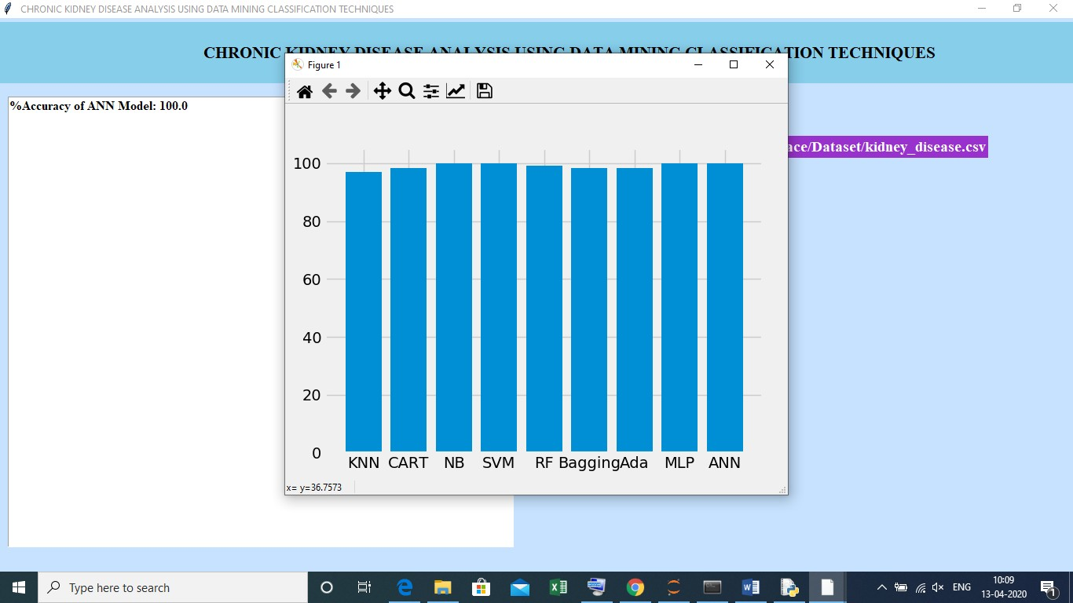
Now click on ‘Model comparison’ the comparison between the models

Slide 24
CONCLUSION
Chronic Kidney Disease has been predicted and diagnosed using data mining classifiers: ANN and Naive Bayes. Performances of these algorithms are compared using Rapidminer tool. The obtained results showed that Naive Bayes is the most accurate classifier with 100% accuracy when compared to ANN having 72.73% accuracy. In this research study, some of the factors considered were age, diabetes, blood pressure, RBC count etc. The work can be extended by considering other parameters like food type, working environment, living conditions, availability of clean water, environmental factors etc for kidney disease detection.
Further studies can be conducted using other classifiers like Fuzzy logic, KNN.

Slide 25
REFERENCES
S. Dilli Arasu, Dr. R. Thirumalaiselvi, “Review of Chronic Kidney Disease based on
Data Mining Techniques”, International Journal of Applied Engineering Research ISSN 0973-4562 Volume 12, Number 23 (2017) pp.
S. Rajarajeswari, T. Tamilarasi, “Chronic Kidney Disease (CKD) Prediction Using
Supervised Data Mining Techniques”, Int. J. Advanced Networking and Applications Volume: 12 Issue: 06 Pages: 4776- 4780 (2021) ISSN: 0975-0290.
Pankaj Chittora, Sandeep Chaurasia, Prasun Chakrabarti, Gaurav Kumawat, Tulika
Chakrabarti, Zbigniew Leonowicz, Michał Jasiński, Łukasz Jasiński, Radomir Gono, Elżbieta Jasińska, And Vadim Bolshev, “Prediction of Chronic Kidney Disease - A Machine Learning Perspective”, Received January 10, 2021, accepted January 15, 2021, date of publication January 22, 2021, date of current version February 1, 2021. Digital Object Identifier 10.1109/ACCESS.2021.3053763.

Slide 26



